Slide 1



Town of Surfside
Town Wide Traffic Study
April 9, 2013

Slide 2
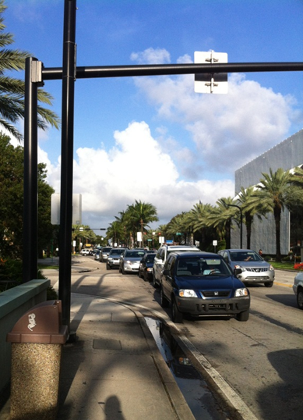
Traffic Analysis Scenarios:
Existing Conditions
Optimized Conditions
2017 Conditions without signal timing improvements
2017 Optimized Conditions

Slide 3
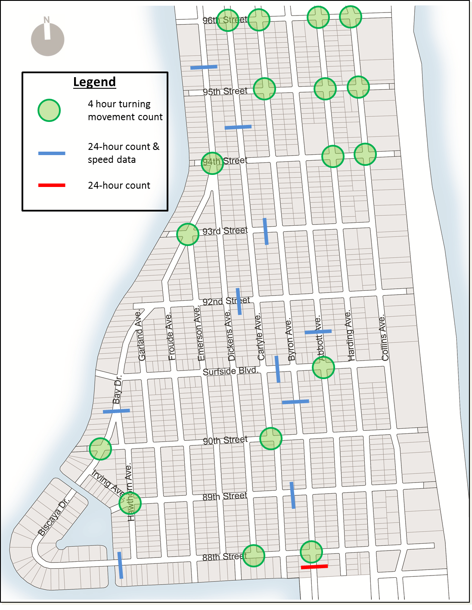
Traffic Count Locations

Slide 4
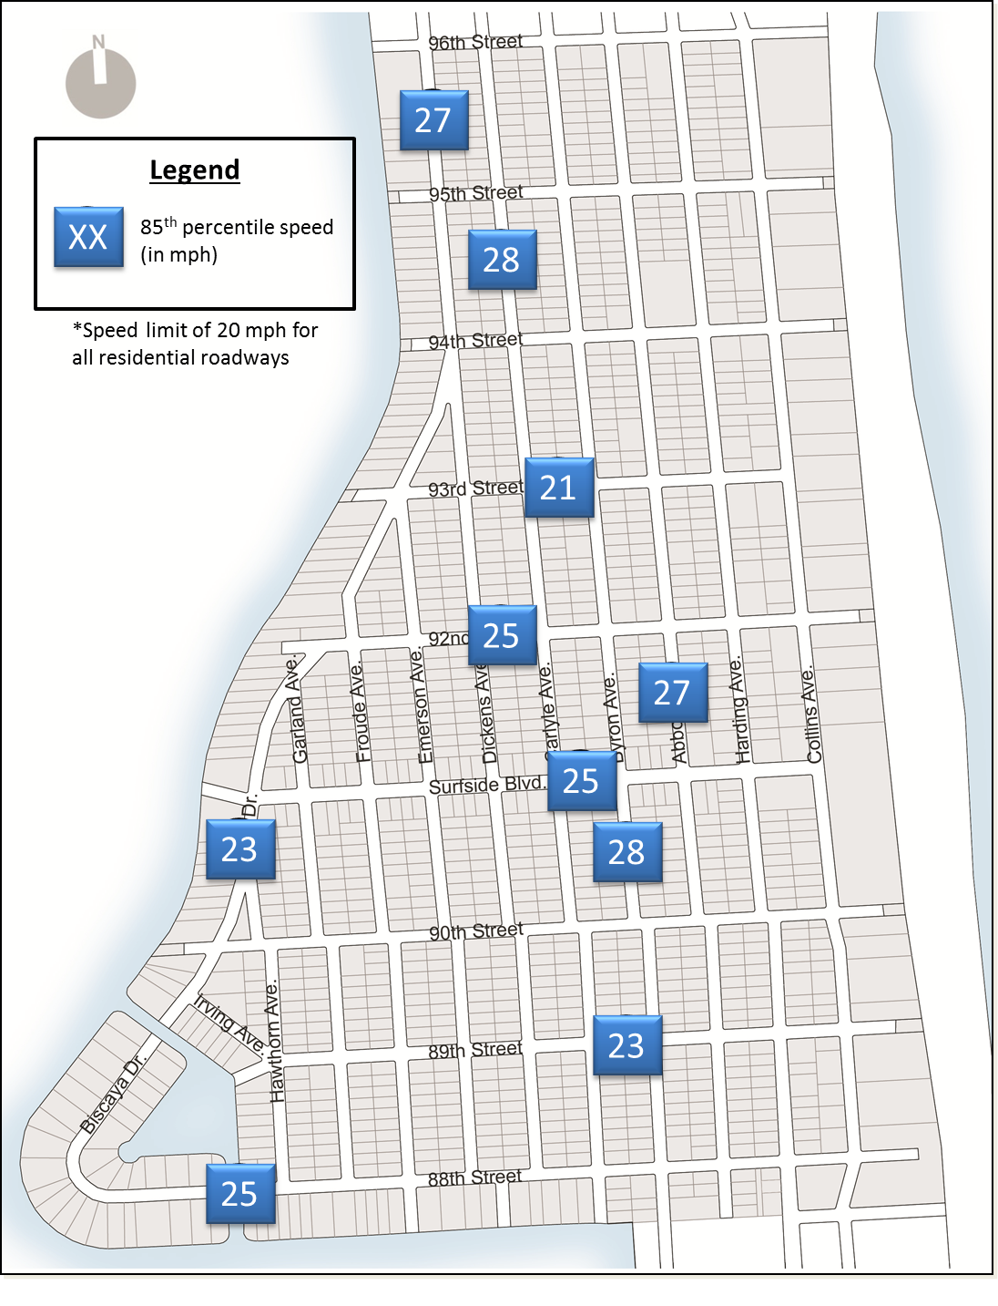
85th Percentile Speeds

Slide 5
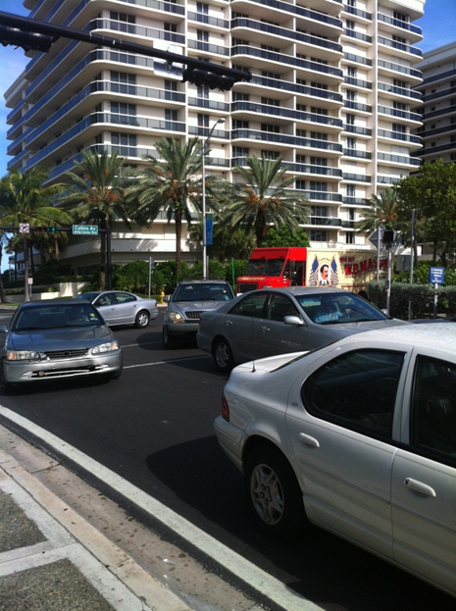
Traffic Analysis Results:
Overall intersection delay within acceptable LOS thresholds
High minor street delays and vehicle queuing
Signal timing improvements will provide significant benefit to residents

Slide 6
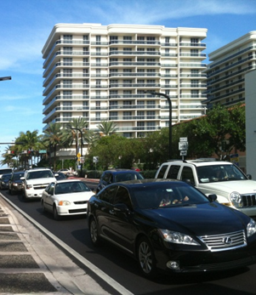
Potential Impacts of New Development
Increase traffic congestion
Signal timing improvements will help mitigate some impact
96th Street at Harding Avenue and Collins Avenue most congested

Slide 7
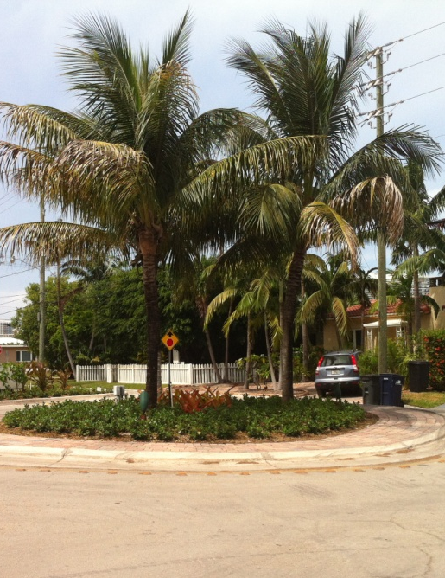
Traffic Calming
Miami-Dade County must approve
2/3 resident approval typically required
Minimum traffic volumes and speed thresholds can be reduced for municipalities that fund their own program

Slide 8
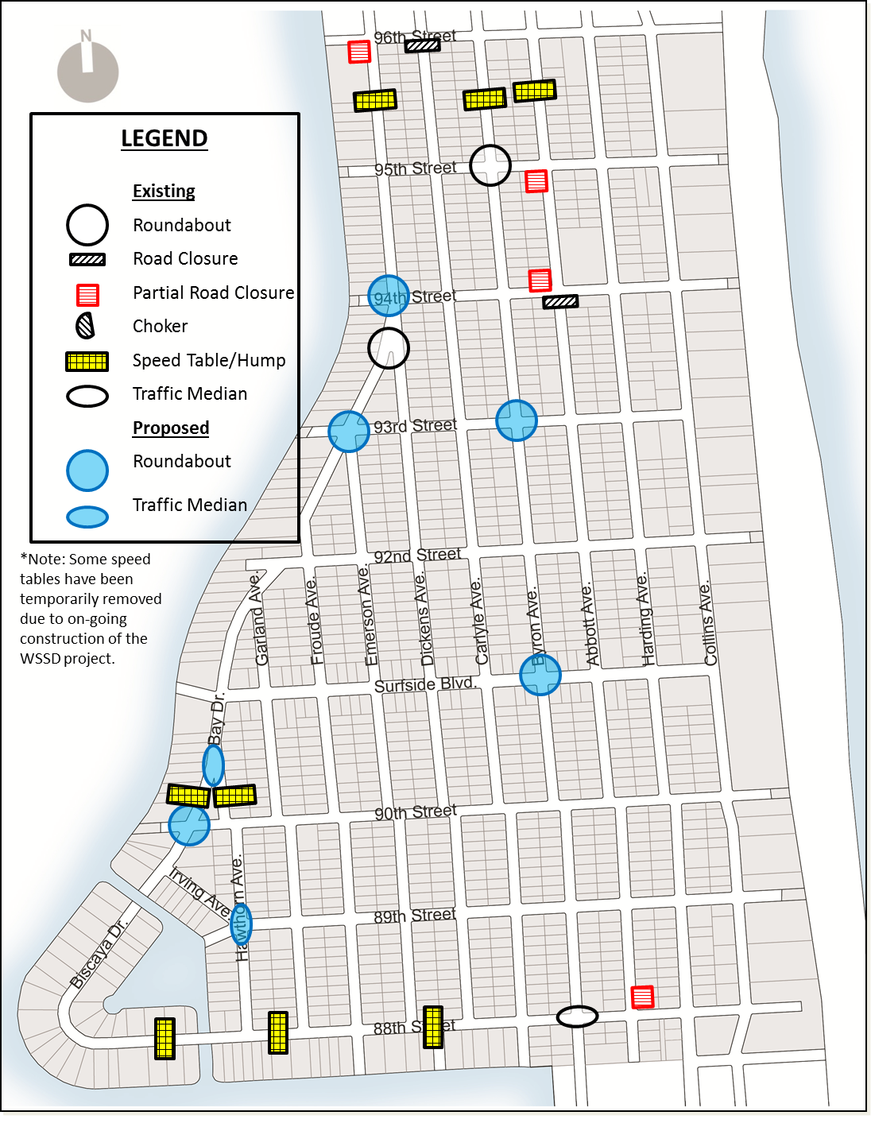
Existing and Proposed Traffic Calming Locations

Slide 9
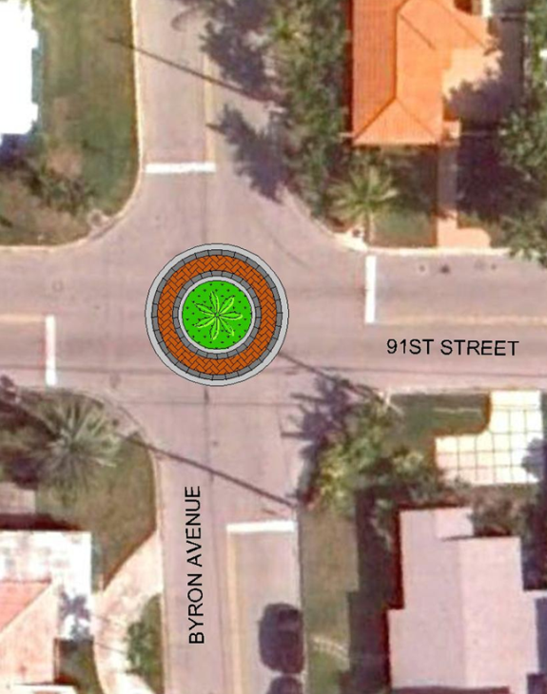
Recommendations
Signal timing improvements
Continue to monitor existing and future traffic patterns
Utilize VISSIM software as a tool to analyze future traffic conditions
Implement new traffic calming devices
1
2
3
4

Slide 10
Thank You

